Slide 1
Decode Block
Instruction Decode

Slide 2
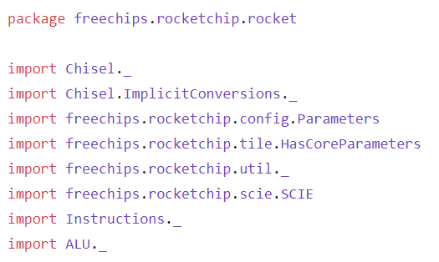
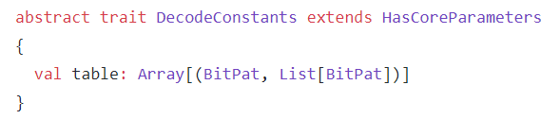
We import different block in instruction Decode which includes ALU block of execute, Parameters from config block and HasCoreParameters from tile block
We create a trait name DecodeConstants and extends that trait with another trait HasCoreParameters which we define in tile block. In trait we created a variable table which returns array (Array which consist of BitPat and List of BitPat)

Slide 3
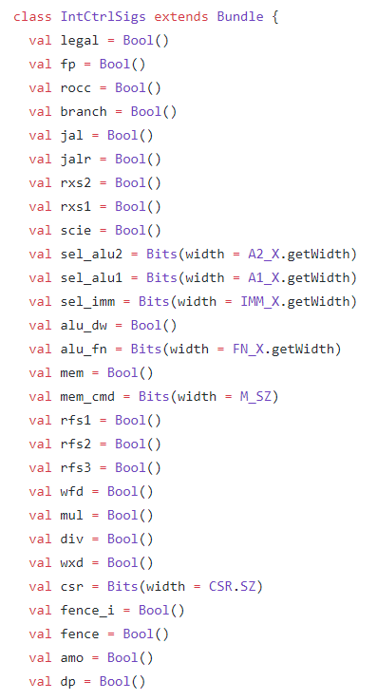
Control Signals | Description
legal | Has type Bool, it tells whether instruction is legal or not
fp | Has type Bool, it tells whether instruction is of floating-point or not
rocc | rocc variable has type Bool
branch | Has type Bool, it tells whether instruction is of branch or not
jal | Has type Bool, it tells whether instruction is of jump and link (jal) or not
jalr | Has type Bool, it tells whether instruction is of jump and link return (jalr) or not
rxs2 | Has type Bool, it tells whether instruction has source register 2 or not
rxs1 | Has type Bool, it tells whether instruction has source register 1 or not
scie | scie variable has type Bool
sel_alu2 | This variable is used to select operand B of ALU by using bits
sel_alu1 | This variable is used to select operand A of ALU by using bits
sel_imm | This variable is used to select immediate bits
alu_dw | Has type Bool, this variable tells Alu data width
alu_fn | This variable returns Aluop bits
mem | Memory variable having type as Bool
mem_cmd | This variable returns bits which can adjust memory size
rfs1 | Has type Bool, used later in List of BitPat for instruction comparing
rfs2 | Has type Bool, used later in List of BitPat for instruction comparing
rfs3 | Has type Bool, used later in List of BitPat for instruction comparing
wfd | Has type Bool, used later in List of BitPat for instruction comparing
mul | Has type Bool, this will tell if instruction is of multiplication
div | Has type Bool, this will tell if instruction is of division
wxd | Has type Bool, it tells whether instruction has write destination register or not
csr | Has type Bits as input
fence_i | Has type input as Bool
fence | Has type input as Bool
amo | Has type input as Bool
dp | Has type input as Bool

Slide 4
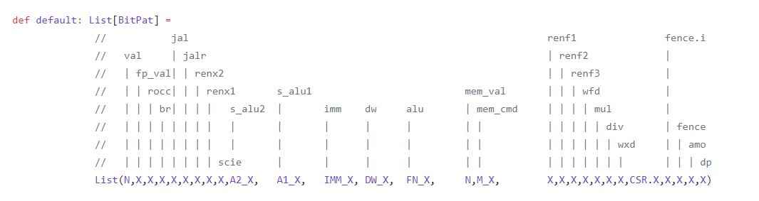
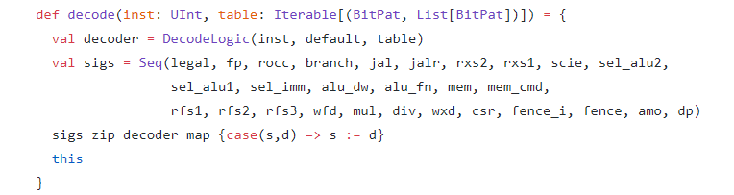
We have define method default in which we create List by using different variables we define above in our trait. Later we uses this List Bit Pattern for our instruction matching
We have define decode method which takes instruction and table as its input parameter. We take table as Iterable trait which means (This is a base trait for all Scala collections that define an iterator method to step through one-by-one the collection's elements)
We have created variable decoder and takes DecodeLogic object as input which consist of instruct, default and table
We have created sigs variable in which we arranged all the variables we define above in our class IntCtrlSigs by using Seq function in Scala.
We uses zip function and merges sigs variable collection and decoder variable collection together
We also uses map method which takes a predicate function and applies it to every element in the collection. It creates a new collection with the result of the predicate function applied to each and every element of the collection
We uses case keyword for matching of sigs(s) and decoder(d) variable and if that match we wired decoder output with sigs variable

Slide 5
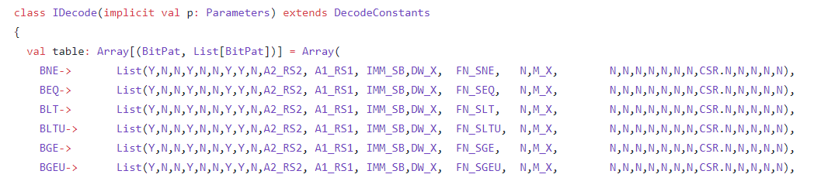
We have created class IDecode (instruction Decode) which is extended by the trait DecodeConstants
We have created table variable which returns array
Instructions
BNE (Branch not equal)
BEQ(Branch equal)
BLT(Branch less than)
BLTU(Branch less than unsigned)
BGE(Branch greater than equal)
BGEU(Branch greater than equal unsigned)
Description
We have Y and N which we uses if we have true we have Y otherwise N.We uses sigs variable sequence in this List. Example In these branch instruction we have 1st ,4th,7th and 8th element position as Y which means we have legal,branch,register file soruce1 and register file source 2 as true. We have 2nd and 3rd position as N which means we don’t have fp(floating point) instruction and rocc instruction. We have IMM_SB (immediate store branch),DW_X(data width of Alu) and Aluop bits as input of List.

Slide 6
Instructions
JAL (Jump and Link)
JALR(Jump and Link return)
AUIPC(Add Upper Immediate to Program Counter)
Description
We have Y and N which we uses if we have true we have Y otherwise N.We uses sigs variable sequence in this List. Example In these instruction we have 1st element position as Y which means we have legal instruction. We have 2nd, 3rd and 4th position as N which means we don’t have fp(floating point) instruction, rocc instruction and branch instruction. We have IMM_UJ(immediate of unconditional jump),IMM_I(immediate of I format instruction),,IMM_U (immediate of unconditional),DW_X(data width of Alu) and Aluop bits as input of List.

Slide 7
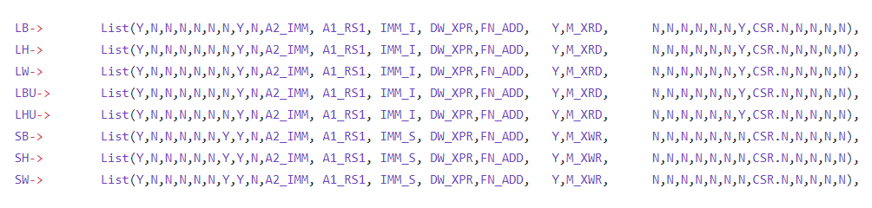
Instructions
LB (Load Byte)
LH (Load Half)
LW (Load Word)
LBU (Load Byte Unsigned)
LHU (Load Half Unsigned)
SB (Store Byte)
SH (Store Half)
SW (Store Word)
Description
We have Y and N which we uses if we have true we have Y otherwise N.We uses sigs variable sequence in this List. Example In these load and store instruction we have 1st element position as Y which means we have legal instruction. We have 2nd, 3rd and 4th position as N which means we don’t have fp(floating point) instruction, rocc instruction and branch instruction. We have IMM_S(immediate of store),IMM_I(immediate of I format instruction), DW_X(data width of Alu) and Aluop bits as input of List. We have single source register in load instruction and have two source register in store instruction.

Slide 8
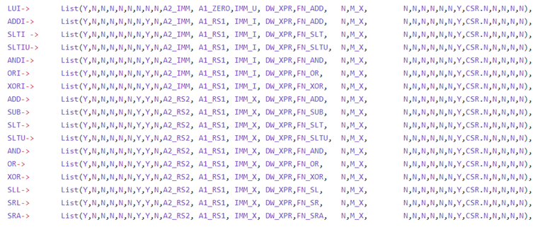
Instructions
LUI (Load Upper Immediate)
ADDI (Addition Immediate)
SLTI (Set Less Than Immediate)
SLTIU (Set Less Than Immediate Unsigned)
ANDI (And Immediate)
ORI (OR Immediate)
XORI (XOR Immediate)
ADD (Addition)
SUB (Subtraction)
SLT (Set Less Than)
SLTU (Set Less Than Unsigned)
AND (AND Logical Operation)
OR (OR Logical Operation)
XOR (XOR logical Operation)
SLL (Shift Left Logical)
SRL (Shift Right Logical)
SRA (Shift Right Arithmetic)
Description
We have Y and N which we uses if we have true we have Y otherwise N.We uses sigs variable sequence in this List. Example In these R format instruction we have 1st element position as Y which means we have legal instruction. We have 2nd, 3rd and 4th position as N which means we don’t have fp(floating point) instruction, rocc instruction and branch instruction. We have IMM_U(Upper Immediate),IMM_I(immediate of I format instruction), DW_X(data width of Alu) and Aluop bits as input of List.

Slide 9
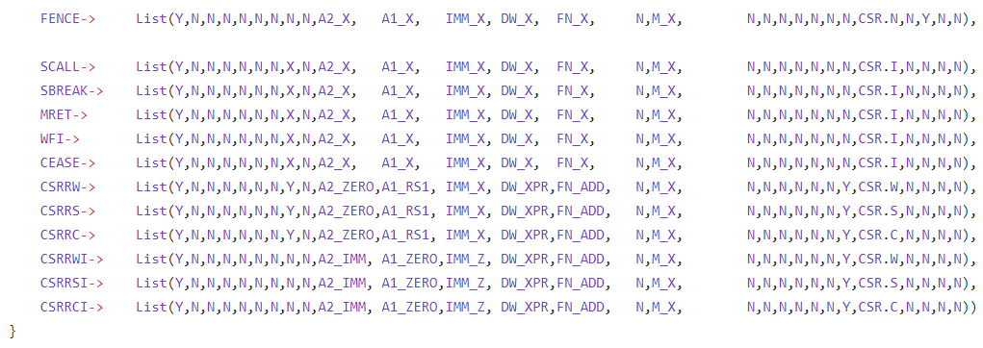
RV32I System Instructions
FENCE (Instruction memory ordering fence (I Format))
SCALL (System call (I Format))
SBREAK(Breakpoint (I Format))
MRET
WFI
CEASE
CSRRW (Read and write CSR (I Format))
CSRRS(Read and set bits in CSR (I Format))
CSRRC (Read and clear bits in CSR (I Format))
CSRRWI (Read and write CSR with immediate (I Format))
CSRRSI (Read and set bits in CSR with immediate (I Format))
CSRRCI (Read and clear bits in CSR with immediate (I Format))
Description
System Instructions Rounding out RV32I are the eight system instructions. Simple implementations may choose to trap these instructions and emulate their functionality in system software, but higher performance implementations may implement more of their functionality in hardware We have Y and N which we uses if we have true we have Y otherwise N.We uses sigs variable sequence in this List. Example In these RV32I system instruction format instruction we have 1st element position as Y which means we have legal instruction. We have 2nd, 3rd and 4th position as N which means we don’t have fp(floating point) instruction, rocc instruction and branch instruction. We have DW_X(data width of Alu) / DW_XPR(data width of Alu) and Aluop bits as input of List(FN_X / FN_ADD)

Slide 10
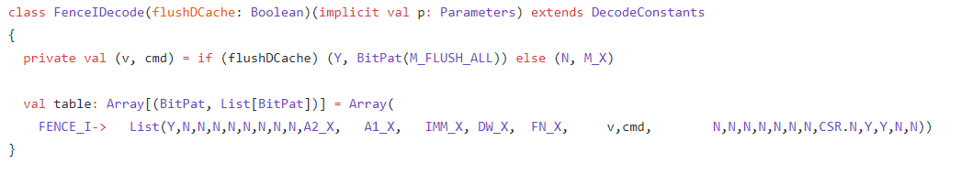
Description
We have created class FenceDecode which takes parameter flushDCache as Boolean type which is extended by trait DecodeConstants. This class is used for pattern matching of RV32I memory access instruction. We have Y and N which we uses if we have true we have Y otherwise N.We uses sigs variable sequence in this List. We have private variable in which we if condition. We uses this variable result later in our List Example In these RV32I memory access instruction we have 1st element position as Y which means we have legal instruction. We have 2nd, position as N which means we have no floating point(fp) instruction. 3rd and 4th position as N which means we don’t have rocc instruction and branch instruction. We have N on 7th and 8th position which means we have no source registers for other extensions. We have N at 16th signal indicating that we have no memcmd for Load instruction. We have Low (N) signal for source registers rfs1, rfs2, rfs3 and wfd (destination floating register) for RVF instruction which is at 17th ,18th, 19th and 20th position respectively. We have DW_X(data width of Alu) and Aluop bits as input of List(FN_X).We have private variable result v,cmd in our List

Slide 11
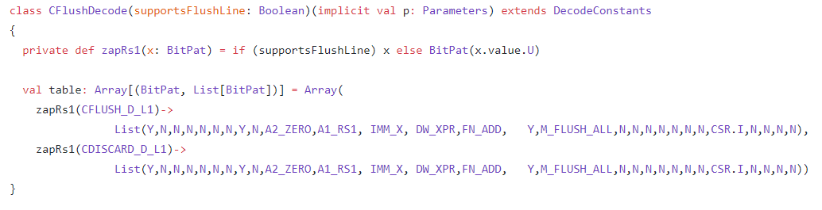
Description
We have created class CFlushDecode.This class is used for flushing cache L1 which takes parameter supportsFlushLine as Boolean type which is extended by trait DecodeConstants. We have Y and N which we uses if we have true we have Y otherwise N.We uses sigs variable sequence in this List. We have private variable in which we if condition. We uses private method zapRs1 and takes BitPat as input parameter. We have if condition in zapRs1 method Example We have 1st element position as Y which means we have legal instruction. We have 2nd, position as N which means we have no floating point(fp) instruction. 3rd and 4th position as N which means we don’t have rocc instruction and branch instruction. We have N on 7th and at 8th position we have Y which means we have single source register.. We have Y at 16th signal indicating that we have memcmd. We have Low (N) signal for source registers rfs1, rfs2, rfs3 and wfd (destination floating register) for RVF instruction which is at 17th ,18th, 19th and 20th position respectively. We have DW_XPR(data width of Alu) and Aluop bits as input of List(FN_ADD).

Slide 12
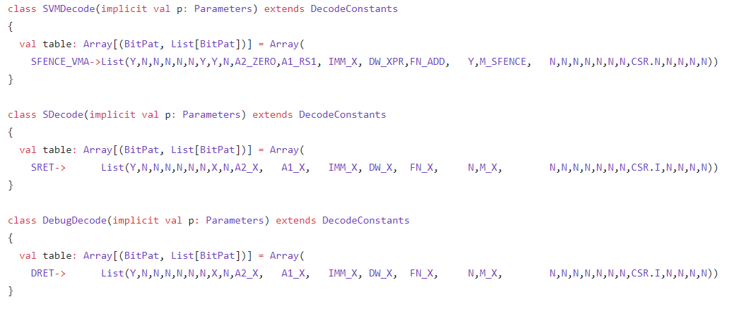
Description
We have created class SVMDecode,SDecode and DebugDecode which are extended by trait DecodeConstants. We have Y and N which we uses if we have true we have Y otherwise N.We uses sigs variable sequence in this List. Example We have SPENCE_VMA,SRET and DRET instructions in which we have 1st element position as Y which means we have legal instruction. We have 2nd, position as N which means we have no floating point(fp) instruction. 3rd and 4th position as N which means we don’t have rocc instruction and branch instruction. We have Y on 7th and at 8th position of SPENCE_VMA and N.We have Y at 15th position which means we have single memval high for SPENCE_VMA and N for SRET and DRET. We have Low (N) signal for source registers rfs1, rfs2, rfs3 and wfd (destination floating register) for RVF instruction which is at 17th ,18th, 19th and 20th position respectively. We have DW_XPR / DW_X(data width of Alu) and Aluop bits as input of List(FN_X).

Slide 13
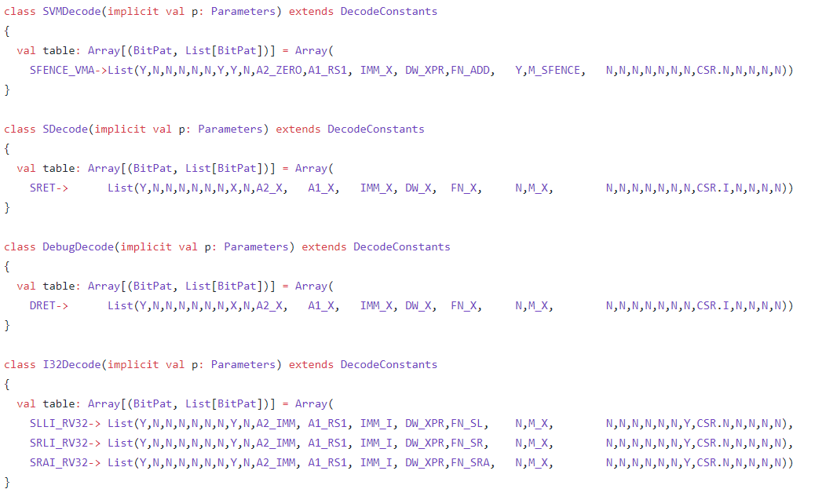
RV64I Instructions
SLLI_RV32 (Shift Left Logical Immediate (RV32))
SRLI_RV32 (Shift Right Logical Immediate (RV32))
SRAI_RV32I (Shift Right Arithmetic Immediate (RV32))
Description
We have created class I32Decode which is extended by trait DecodeConstants. This class is used for pattern matching of RV32I instructions We have Y and N which we uses if we have true we have Y otherwise N.We uses sigs variable sequence in this List. Example In these RV32I format instruction we have 1st element position as Y which means we have legal instruction. We have 2nd, 3rd and 4th position as N which means we don’t have fp(floating point) instruction, rocc instruction and branch instruction. We have IMM_S(Immediate of Store),IMM_I(immediate of I format instruction), DW_XPR(data width of Alu) and Aluop bits as input of List(for example FN_SL,FN_SR etc).

Slide 14
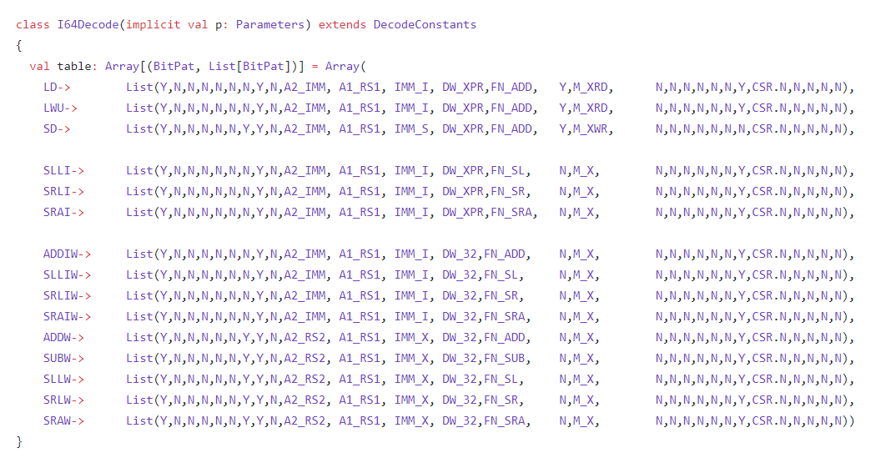
RV64I Instructions
LD (Load Data)
LWU(Load Word Unsigned)
SD (Store Data)
SLLI(Shift Left Logical Immediate)
SRLI(Shift Right Logical Immediate)
SRAI(Shift Right Arithmetic Immediate)
ADDIW (Addition Immediate)
SLLIW (Shift Left Logical Immediate (RV64))
SRLIW (Shift Right Logical Immediate (RV64))
SRAIW (Shift Right Arithmetic Immediate (RV64))
ADDW (Addition (RV64))
SUBW (Subtraction (RV64))
SLLW (Shift Left Logical (RV64))
SRLW (Shift Right Logical (RV64))
SRAW(Shift Right Arithmetic (RV64))
Description
We have created class I64Decode which is extended by trait DecodeConstants. This class is used for pattern matching of RV64I instructions We have Y and N which we uses if we have true we have Y otherwise N.We uses sigs variable sequence in this List. Example In these RV64I format instruction we have 1st element position as Y which means we have legal instruction. We have 2nd, 3rd and 4th position as N which means we don’t have fp(floating point) instruction, rocc instruction and branch instruction. We have IMM_S(Immediate of Store),IMM_I(immediate of I format instruction), DW_32(data width of Alu) and Aluop bits as input of List(for example FN_ADD,FN_SL etc).

Slide 15
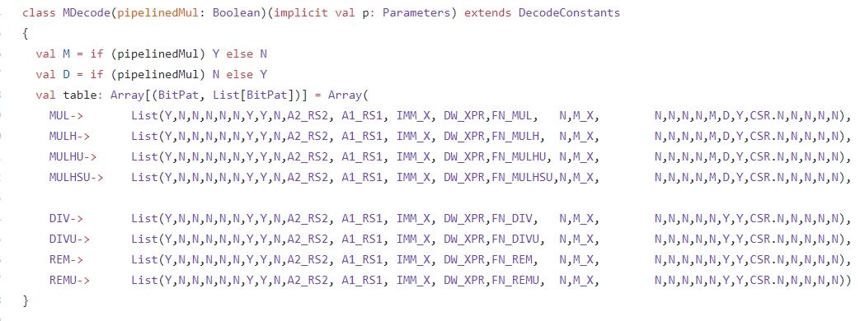
M extension Instructions
MUL (Multiplication)
MULH (Multiplication half word)
MULHU (Multiplication Half Word Unsigned)
MULHSU (Multiplication Half Word Signed Unsigned)
DIV (Division)
DIVU (Division Unsigned)
REM (Remainder)
REMU (Remainder Unsinged)
Description
We have created class MDecode (takes pipelineMul as Bool type input) which is extended by trait DecodeConstants. This class is used for pattern matching of M extension instructions. We have two variables M and D in which we have if condition which decides weather we have Y and N We have Y and N which we uses if we have true we have Y otherwise N.We uses sigs variable sequence in this List. Example In these M extension format instruction we have 1st element position as Y which means we have legal instruction. We have 2nd, 3rd and 4th position as N which means we don’t have fp(floating point) instruction, rocc instruction and branch instruction. We have Y on 7th and 8th position which means we have two source registers. We have Y at 22nd position for division and remainder instructions and we have Y at 23rd signal indicating that we have write register We have DW_XPR(data width of Alu) and Aluop bits as input of List(for example FN_DIV,FN_REM etc).

Slide 16
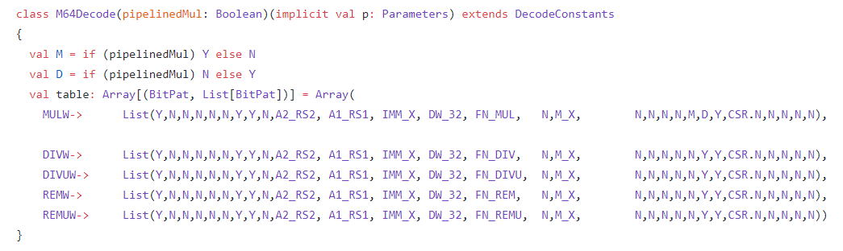
M extension (RV64) Instructions
MULW (Multiplication (RV64))
MULH (Multiplication half word)
DIVW (Division (RV64))
DIVUW (Division Unsigned (RV64))
REMW (Remainder (RV64))
REMUW (Remainder Unsinged (RV64))
Description
We have created class M64Decode (takes pipelineMul as Bool type input) which is extended by trait DecodeConstants. This class is used for pattern matching of M extension instructions. We have two variables M and D in which we have if condition which decides weather we have Y and N We have Y and N which we uses if we have true we have Y otherwise N.We uses sigs variable sequence in this List. Example In these M extension format instruction(RV64) we have 1st element position as Y which means we have legal instruction. We have 2nd, 3rd and 4th position as N which means we don’t have fp(floating point) instruction, rocc instruction and branch instruction. We have Y on 7th and 8th position which means we have two source registers. We have Y at 22nd position for division and remainder instructions and we have Y at 23rd signal indicating that we have write register We have DW_32(data width of Alu) and Aluop bits as input of List(for example FN_DIV,FN_REM etc).

Slide 17
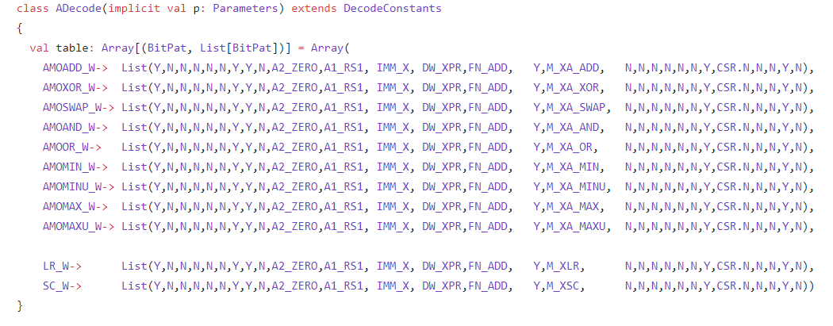
RVA Instructions
AMOADD_W (Atomic addition)
AMOXOR_W(Atomic bitwise XOR )
AMOSWAP_W (Atomic swap )
AMOAND_W (Atomic bitwise AND)
AMOOR_W (Atomic bitwise OR)
AMOMIN_W (Atomic two’s complement minimum)
AMOMAX_W (Atomic two’s complement maximum)
AMOMAXU_W (Atomic unsigned maximum )
LR_W (Load reserved )
SC_W (Store conditional )
Description
The instructions with the w suffix operate on 32-bit words. We have created class ADecode which is extended by trait DecodeConstants. This class is used for pattern matching of RVA Instructions. We have Y and N which we uses if we have true we have Y otherwise N.We uses sigs variable sequence in this List. Example In these RVA Instructions we have 1st element position as Y which means we have legal instruction. We have 2nd, 3rd and 4th position as N which means we don’t have fp(floating point) instruction, rocc instruction and branch instruction. We have Y on 7th and 8th position which means we have two source registers. We have Y at 23rd signal indicating that we have write register. We have high signal amo (Y) for all RVA instruction which is at 27th position. We have DW_XPR(data width of Alu) and Aluop bits as input of List(for example FN_DIV,FN_REM etc).

Slide 18
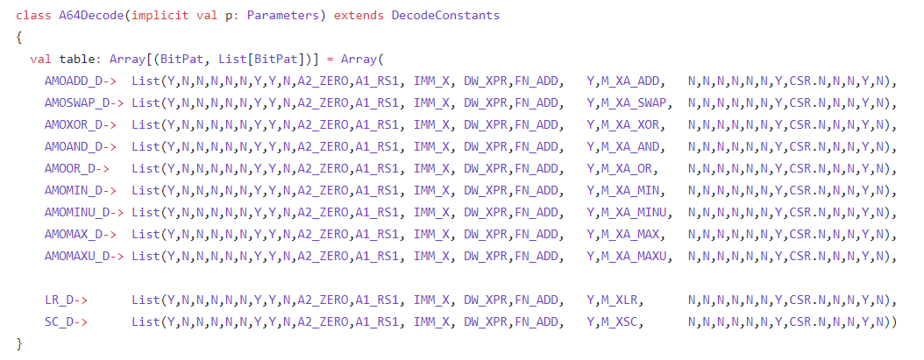
RVA64 Instructions
AMOADD_D (Atomic addition)
AMOXOR_D(Atomic bitwise XOR )
AMOSWAP_D (Atomic swap )
AMOAND_D (Atomic bitwise AND)
AMOOR_D (Atomic bitwise OR)
AMOMIN_D (Atomic two’s complement minimum)
AMOMAX_D (Atomic two’s complement maximum)
AMOMAXU_D (Atomic unsigned maximum )
LR_D (Load reserved )
SC_D (Store conditional )
Description
The instructions with the D suffix operate on 64-bit words. We have created class A64Decode which is extended by trait DecodeConstants. This class is used for pattern matching of RVA Instructions. We have Y and N which we uses if we have true we have Y otherwise N.We uses sigs variable sequence in this List. Example In these RVA Instructions we have 1st element position as Y which means we have legal instruction. We have 2nd, 3rd and 4th position as N which means we don’t have fp(floating point) instruction, rocc instruction and branch instruction. We have Y on 7th and 8th position which means we have two source registers. We have Y at 23rd signal indicating that we have write register. We have high signal amo (Y) for all RVA64 instruction which is at 27th position. We have DW_XPR(data width of Alu) and Aluop bits as input of List(for example FN_ADD).

Slide 19
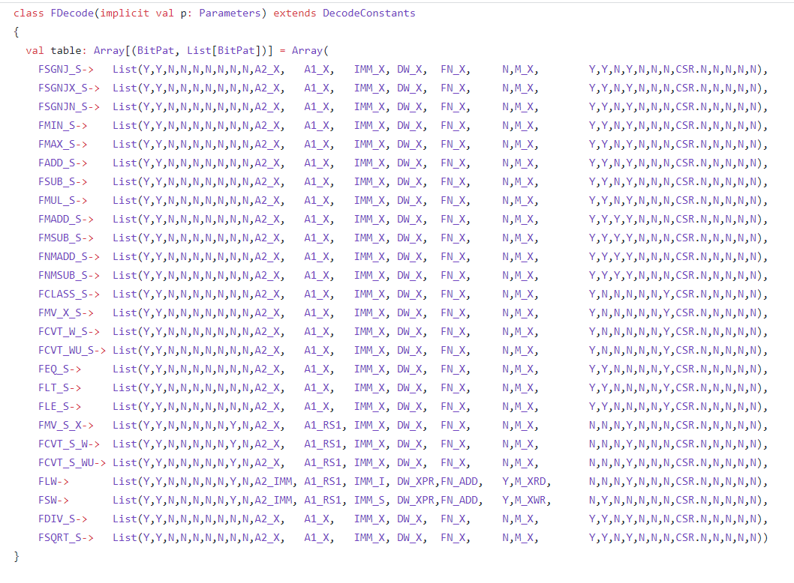
RVF Instructions
FSGNJ_S (Inject sign (R Format))
FSGNJX_S(Multiply signs(R Format))
FSGNJN_S (Inject complement of sign (R Format) )
FMIN_S (Compute minimum of two values (R Format))
FMAX_S(Compute maximum of two values (R Format))
FADD_S (Add two registers (R Format))
FSUB_S (Subtract two registers (R Format))
FMUL_S (Multiply two registers (R Format))
FMADD_S ( (fs1×fs2+fs3) where s1,s2,s3 are source register (R Format))
FMSUB_S ( (fs1×fs2-fs3) where s1,s2,s3 are source register (R Format))
FNMADD_S ( - (fs1×fs2+fs3) where s1,s2,s3 are source register (R Format))
FNMSUB_S ( - (fs1×fs2-fs3) where s1,s2,s3 are source register (R Format))
FCLASS_S (Classify floating-point value (R Format))
FMV_X_S (Move from floating-point to integer register(R Format))
FCVT_W_S (Convert to signed 32-bit integer (R Format))
FCVT_WU_S (Convert to [un]signed 32-bit integer (R Format))
FEQ_S (Set if equal (R Format))
FLT_S (Set if less than (R Format))
FLE_S (Set if less than or equal (R Format))
FMV_S_X (Move from integer to floating-point register (R Format))
FCVT_S_W (Convert from signed 32-bit integer (R Format))
FCVT_S_WU (Convert from unsigned 32-bit integer (R Format))
FLW (Load 32-bit floating-point word (I Format))
FSW (Store 32-bit floating-point word (I Format)
FDIV_S (Divide two registers (R Format))
FSQRT_S (Compute square root (R Format))
Description
We have created class FDecode which is extended by trait DecodeConstants. This class is used for pattern matching of RVF Instructions. We have Y and N which we uses if we have true we have Y otherwise N.We uses sigs variable sequence in this List. Example In these RVF Instructions we have 1st element position as Y which means we have legal instruction. We have 2nd, position as Y which means we have floating point(fp) instruction. 3rd and 4th position as N which means we don’t have rocc instruction and branch instruction. We have N on 7th and 8th position which means we have no source registers for other extensions. We have Y at 23rd signal indicating that we have write register. We have high signal (Y) for source registers rfs1, rfs2, rfs3 and wfd (destination floating register) for RVF instruction which is at 17th ,18th, 19th and 20th position respectively. We have DW_X(data width of Alu) and Aluop bits as input of List(FN_X). Instruction Example FSGNJ copies the sign from a second number; FSGNJN copies the negated sign from a second number; and FSGNJX takes the new sign from the product of the two input sign

Slide 20
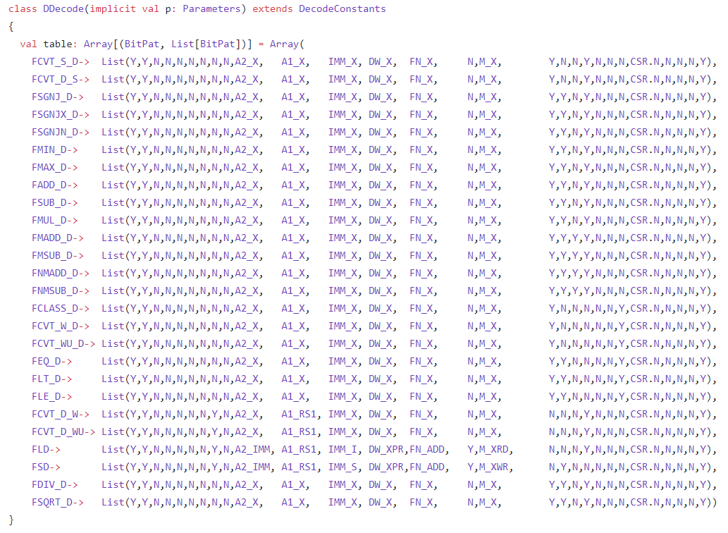
RVD Instructions
FSGNJ_D (Inject sign (R Format))
FSGNJX_D (Multiply signs (R Format))
FSGNJN_D (Inject complement of sign (R Format) )
FMIN_D (Compute minimum of two values (R Format))
FMAX_D (Compute maximum of two values (R Format))
FADD_D (Add two registers (R Format))
FSUB_D (Subtract two registers (R Format))
FMUL_D (Multiply two registers (R Format))
FMADD_D ( (fs1×fs2+fs3) where s1,s2,s3 are source register (R Format))
FMSUB_D ( (fs1×fs2+fs3) where s1,s2,s3 are source register (R Format))
FNMADD_D ( - (fs1×fs2+fs3) where s1,s2,s3 are source register (R Format))
FNMSUB_D ( - (fs1×fs2-fs3) where s1,s2,s3 are source register (R Format))
FCLASS_D (Classify floating-point value (R Format))
FMV_X_D (Move from F.P. to integer register (RV64)(R Format))
FCVT_W_D (Convert to signed 32-bit integer (R Format))
FCVT_WU_D (Convert to [un]signed 32-bit integer (R Format))
FEQ_D (Set if equal (R Format))
FLT_D (Set if less than (R Format))
FLE_D (Set if less than or equal (R Format))
FMV_D_X (Move from integer to floating-point register (R Format))
FCVT_D_W (Convert from signed 32-bit integer (R Format))
FCVT_D_WU (Convert from unsigned 32-bit integer (R Format))
FLW (Load 32-bit floating-point word (I Format))
FDW (Store 32-bit floating-point word (I Format)
FDIV_D (Divide two registers (R Format))
FSQRT_D (Compute square root (R Format))
Description
The D extension is structured very similarly to the F extension, and indeed requires the presence of the F extension. The 32 floating-point registers are doubled in width to 64 bits, and new instructions are added that operate on double-precision values. 32-bit and 64- bit floats cannot be freely mixed in computational instructions, but instructions to convert between the formats (FCVT.D.S and FCVT.S.D) are provided to support mixed-format code. We have created class FDecode which is extended by trait DecodeConstants. This class is used for pattern matching of RVF Instructions. We have Y and N which we uses if we have true we have Y otherwise N.We uses sigs variable sequence in this List. Example In these RVD Instructions we have 1st element position as Y which means we have legal instruction. We have 2nd, position as Y which means we have floating point(fp) instruction. 3rd and 4th position as N which means we don’t have rocc instruction and branch instruction. We have N on 7th and 8th position which means we have no source registers for other extensions. We have Y at 27th signal indicating that we have dp (double floating point). We have high signal (Y) for source registers rfs1, rfs2, rfs3 and wfd (destination floating register) for RVF instruction which is at 17th ,18th, 19th and 20th position respectively. We have DW_X(data width of Alu) and Aluop bits as input of List(FN_X).

Slide 21
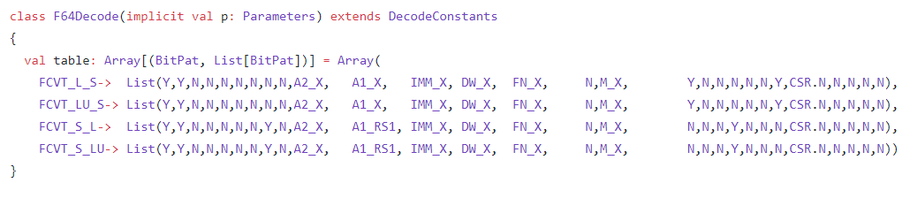
Description
We have created class F64Decode which is extended by trait DecodeConstants. This class is used for pattern matching of RVF64 Instructions. We have Y and N which we uses if we have true we have Y otherwise N.We uses sigs variable sequence in this List. Example In these RVF64 Instructions we have 1st element position as Y which means we have legal instruction. We have 2nd, position as Y which means we have floating point(fp) instruction. 3rd and 4th position as N which means we don’t have rocc instruction and branch instruction. We have N on 7th and 8th position which means we have no source registers for other extensions. We have Y at 16th signal indicating that we have memcmd for Load instruction. We have high signal (Y) or Low (N) signal for source registers rfs1, rfs2, rfs3 and wfd (destination floating register) for RVF instruction which is at 17th ,18th, 19th and 20th position respectively. We have DW_X(data width of Alu) and Aluop bits as input of List(FN_X).
RVF64 Instructions
FCV_L_S (Convert to signed 64-bit integer (RV64) (R Format))
FCVT_LU_S(Convert to [un]signed 64-bit integer (RV64) (R Format))
FCVT_S_L (Convert from signed 64-bit integer (RV64) (R Format) )
FCVT_S_LU (Convert from [un]signed 64-bit integer (RV64) (R Format))

Slide 22
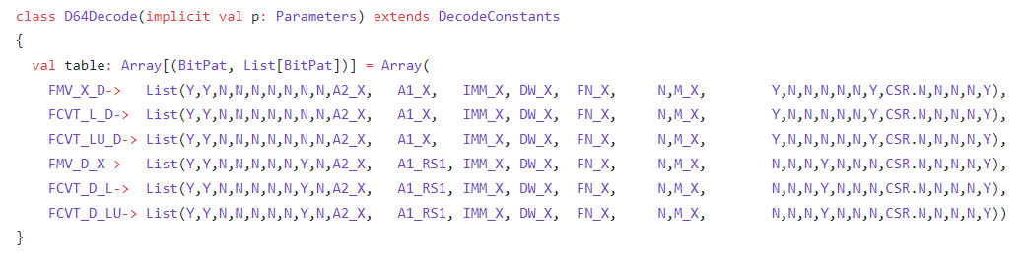
Description
We have created class D64Decode which is extended by trait DecodeConstants. This class is used for pattern matching of RVD64 Instructions. We have Y and N which we uses if we have true we have Y otherwise N.We uses sigs variable sequence in this List. Example In these RVD64 Instructions we have 1st element position as Y which means we have legal instruction. We have 2nd, position as Y which means we have floating point(fp) instruction. 3rd and 4th position as N which means we don’t have rocc instruction and branch instruction. We have N on 7th and 8th position which means we have no source registers for other extensions. We have Y at 16th signal indicating that we have memcmd for Load instruction. We have high signal (Y) or Low (N) signal for source registers rfs1, rfs2, rfs3 and wfd (destination floating register) for RVF instruction which is at 17th ,18th, 19th and 20th position respectively. We have Y at 27th signal indicating that we have dp (double floating point). We have DW_X(data width of Alu) and Aluop bits as input of List(FN_X).
RVD64 Instructions
FMV_X_D (Move from F.P. to integer register (RV64) (R Format))
FCVT_L_D(Convert to signed 64-bit integer (RV64) (R Format))
FCVT_LU_D (Convert to [un]signed 64-bit integer (RV64) (R Format) )
FMV_D_X (Move from integer to F.P. register (RV64) (R Format))
FCVT_D_L(Convert from signed 64-bit integer (RV64) (R Format))
FCVT_D_LU(Convert from [un]signed 64-bit integer (RV64) (R Format))

Slide 23
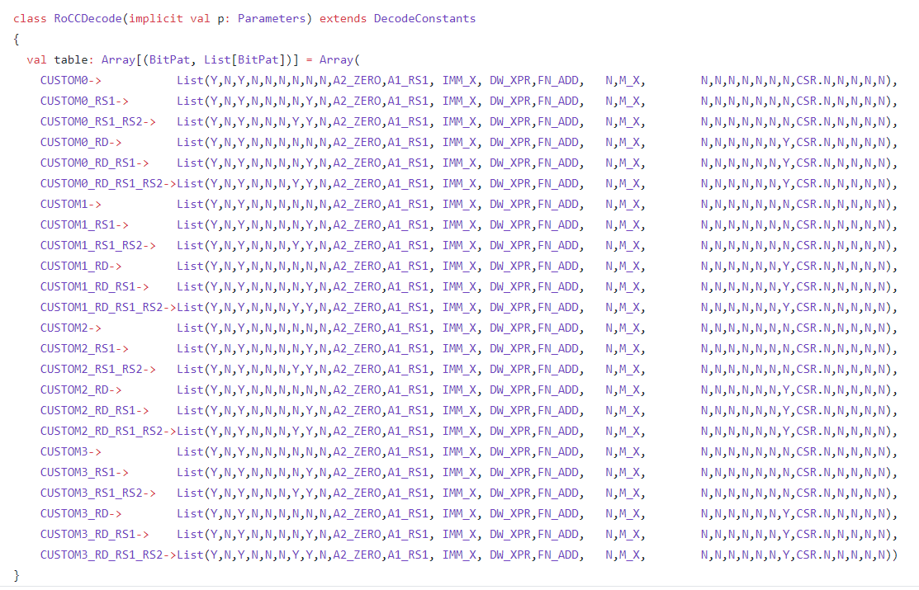
Description
We have created class RoCCDecode which is extended by trait DecodeConstants. This class is used for pattern matching of RoCC Instructions. We have Y and N which we uses if we have true we have Y otherwise N.We uses sigs variable sequence in this List. Example In these RoCC Instructions we have 1st element position as Y which means we have legal instruction. We have 2nd, position as N which means we have floating point(fp) instruction. 3rd position as Y which means we have Rocc instructions. At 4th position we have N which means we don’t have rocc instruction and branch instruction. We have N/Y on 7th and 8th position which means whether we have source registers or not . We have N at 16th signal indicating that we do not have memcmd for Load instruction. We have high signal Low (N) signal for source registers rfs1, rfs2, rfs3 and wfd (destination floating register) for RVF instruction which is at 17th ,18th, 19th and 20th position respectively. We have N at 27th signal indicating that we do not have dp (double floating point). We have DW_XPR(data width of Alu) and Aluop bits as input of List(FN_ADD).

Slide 24
1 instruction of a not included minu

